Slide 1




Md Amjad Hossain
(Based on slides prepared Hyrum D. Carroll and Suk Jin Lee)

Slide 2
Dynamic programming
It is used, when the solution can be recursively described in terms of solutions to subproblems (optimal substructure)
Divide-and-Conquer is applied on disjoint subproblems.
Dynamic Programming on subproblems with overlaps.
Algorithm solves each subproblem just once and stores its answer in memory (a table) for later use.
More efficient than “brute-force methods”/Divided and conquer, which solve the same subproblems over and over again.
Call such a solution an optimal solution to the problem, as opposed to the optimal solution

Slide 3
Dynamic programming
Follow a sequence of four steps:
Characterize the structure of an optimal solution.
Recursively define the value of an optimal solution.
Compute the value of an optimal solution, typically in a bottom-up fashion.
Construct an optimal solution from computed information. ( this one is not required if you only need the optimal value)

Slide 4
Rod-cutting Problem
How to cut steel rods into pieces in order to maximize the revenue you can get?
Each cut is free
Rod lengths are always an integral number of inches
Definition
Input: A rod of length n inches and a table of prices p_{i}, for i = 1, 2,…, n
Output: determine the maximum revenue r_{n} obtainable by cutting up the rod and selling the pieces

Slide 5
Rod-cutting Problem
Example
A table of prices p_{i}
Length i | 1 | 2 | 3 | 4 | 5 | 6 | 7 | 8 | 9 | 10
Price p_{i} | 1 | 5 | 8 | 9 | 10 | 17 | 17 | 20 | 24 | 30
When n = 4, cut the length n in 2^{n−1} different ways
9 1 8 5 5 8
1
1
1
5
1
5
1
5
1
1
1
1
1
1
Optimal value r_4 = 10
Cutting pieces are 2, 2 inches

Slide 6
Rod-cutting Problem
When n = 7, a rod of length 7 is cut into three pieces
7 = 2 + 2 + 3 – two of length 2 and one of length 3, optimal value is 18
If an optimal solution cuts the rod into k pieces for 1 :: k :: n, then an optimal decomposition
n = i₁ + i₂ + ... + i_{k}
Provides maximum corresponding revenue
r_{n} = p_{i} + p_{i} +.+ p_{i}
1 2
k

Slide 7
Rod-cutting Problem
Length i | 1 | 2 | 3 | 4 | 5 | 6 | 7 | 8 | 9 | 10
Price p_{i} | 1 | 5 | 8 | 9 | 10 | 17 | 17 | 20 | 24 | 30
Maximum revenue:
r₁ = 1 from solution 1 = 1 (no cuts), r₂ = 5 from solution 2 = 2 (no cuts), r₃ = 8 from solution 3 = 3 (no cuts), r₄ = 10 from solution 4 = 2 + 2,
r₅ = 13 from solution 5 = 2 + 3,
r₆ = 17 from solution 6 = 6 (no cuts),
r₇ = 18 from solution 7 = 1 + 6 or 7 = 2 + 2 + 3,
r₈ = 22 from solution 8 = 2 + 6,
r₉ = 25 from solution 9 = 3 + 6,
from solution 10 = 10 (no cuts),
r₁₀ = 30
First piece of length i and then a remainder of length n – i
r_{n} = max(p_{i}
^{+ r}n−i ⁾
1≤i≤n
i
n – i

Slide 8
Recursive top-down implementation
Input: an array p[1 . . n] and an integer n
Cut-Rod(p, n)
// p: prices
if n == 0
return 0
q = −οο
// Initialize the maximum revenue q to −οο
4. for i = 1 to n
5. q = max(q, p[i] + Cut-Rod(p, n − i)) //
r_{n} = max(p_{i}
^{+ r}n−i ⁾
1≤i≤n
6. return q
Each time you increase n by 1, your program’s running time would approximately double.

Slide 9
Recursive top-down implementation
Recursion tree
Recursive calls resulting from a call CUT-ROD(p, r) for n = 4
4
3
2
1
0
2
1
0 0
0
1
0
0
1
0
0
In general, this recursion tree has 2^{n} nodes and 2^{n – 1} leaves.
Length i | 1 | 2 | 3 | 4 | 5 | 6 | 7 | 8 | 9 | 10
Price p_{i} | 1 | 5 | 8 | 9 | 10 | 17 | 17 | 20 | 24 | 30

Slide 10
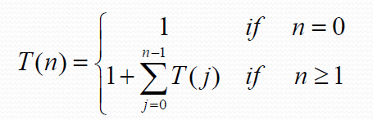
Recursive top-down implementation
Recursion tree
Lots of repeated subproblems
Solve the subproblem for size 2 twice, for size 1 four times, and for size 0 eight times
Exponential growth
3
2
1
0
2
1
0 0
0
1
0
0
1
0
Solution to recurrence: T(n) = 2^{n}
0
In general, this recursion tree has 2^{n} nodes and 2^{n – 1} leaves.

Slide 11



Slide 12
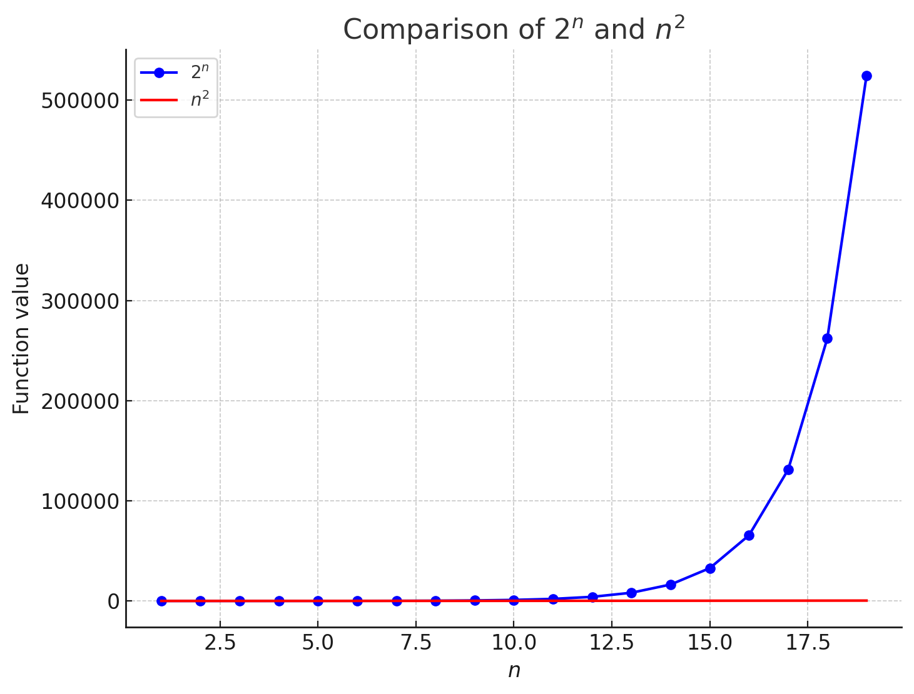
Dynamic-programming solution
Instead of solving the same subproblems repeatedly, arrange to solve each subproblem just once.
Save the solution to a subproblem in a table, and refer back to the table whenever we revisit the subproblem.
“Store, don’t recompute” ⇒ time-memory trade-off
Can turn an exponential-time solution into a polynomial-time solution.
Two basic approaches: top-down with memoization¹, and bottom-up
¹ This is not a misspelling. Memoization comes from memo, since the technique consists of recording a value so that we can look it up later

Slide 13
Using dynamic programming for optimal rod cutting
Top-down approach with memoization
To find the solution to a subproblem, first look in the table.
If the answer is there, use it.
Otherwise, compute the solution to the subproblem and then store the solution in the table for future use
Memoized ⇒ it “remembers” what results it has computed previously

Slide 14
Using dynamic programming for optimal rod cutting
Top-down approach with memoization
Memoized-Cut-Rod(p, n)
Let r[0 . . n] be a new array
for i = 0 to n
3. r[i]= −οο
// Initializes a new array r[0 . . n] with −οο (unknown)
4. return Memoized-Cut-Rod-Aux(p, n, r)

Slide 15
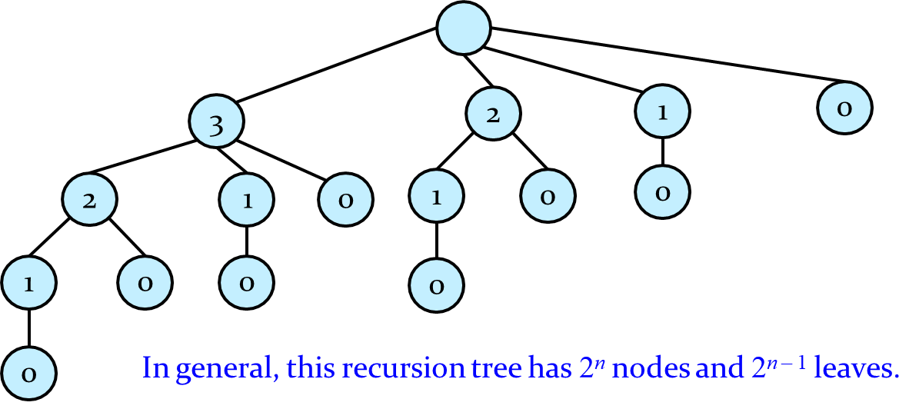

Using dynamic programming for optimal rod cutting
Top-down approach with memoization
Memoized-Cut-Rod-Aux(p, n, r)
1. if r[n] $≥$ 0
// check to see whether the desired value is already known
2. return r[n]
// if the desired value is known
3. if n == 0
// compute the desired value q in the usual manner if it is unknown
4. q = 0
5. else q = −οο
// the solution is unknown
6.
7.
for i = 1 to n
q = max(q, p[i] + MEMOIZED-CUT-ROD-AUX(p, n−i, r))
r[n] = q
return q
The procedure MEMOIZED-CUT-ROD-AUX is just the memoized version of the previous procedure, CUT-ROD.
// Save the computed value q in r[n]

Slide 16
Using dynamic programming for optimal rod cutting
Bottom-up approach
Bottom-Up-Cut-Rod(p, n)
1. Let r[0 . . n] be a new array
// create a new array to save the results
r[0] = 0
for j = 1 to n
// a rod of length 0 earns no revenue
4.
5.
6.
7.
q = −οο
for i = 1 to j
Solve each subproblem of size j, for j
= 1, 2,..., n, in order of increasing size
// i < j
q = max(q, p[i] + r[j − i])
r[j] = q // Save the solution to the subproblem of size j in r[n]
8. return r[n]
Directly references array entry r[j – i] instead of making a recursive call to solve the subproblem j – i

Slide 17
Using dynamic programming for optimal rod cutting
Running time
Bottom-Up-Cut-Rod
Doubly-nested loop structure
Number of iterations of inner for loop forms an arithmetic series
Memoized-Cut-Rod
for loop of lines 6 – 7 iterates n times
Total number of iterations forms an arithmetic series

Slide 18
Using dynamic programming for optimal rod cutting
Running time
Bottom-Up-Cut-Rod
Doubly-nested loop structure
Number of iterations of inner for loop forms an arithmetic series
⇒ 0(n²)
Memoized-Cut-Rod
for loop of lines 6 – 7 iterates n times
Total number of iterations forms an arithmetic series
⇒ 0(n²)

Slide 19
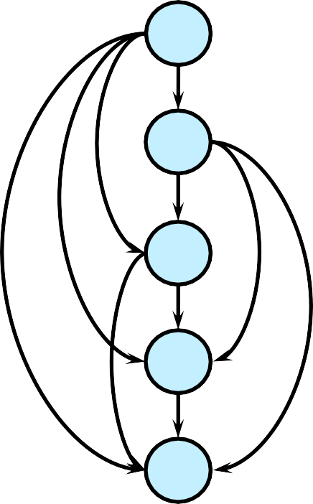
Subproblem graphs
How to understand the subproblems involved and how they depend on each other.
Directed graph:
Vertex labels: sizes of the corresponding subproblems
Directed edge (x, y): need a solution to subproblem y when solving subproblem x
Example: For the rod-cutting problem
with n = 4
4
3
2
1
0

Slide 20
Reconstructing a solution
So far, have focused on computing the value of an optimal solution, rather than the choices that produced an optimal solution
Extend the bottom-up approach to record not just optimal values, but optimal choices
Save the optimal choices in a separate table (s[ ])
Then use a separate procedure to print the optimal choices.

Slide 21
Reconstructing a solution
Extended version of BOTTOM-UP-CUT-ROD
Extended-Bottom-Up-Cut-Rod(p, n)
1. Let r[0 . . n] and s[1 . . n] be new arrays
// s_{j}: optimal size of the first piece to cut
r[0] = 0
for j = 1 to n
// a rod of length 0 earns no revenue
4.
5.
6.
7.
8.
9.
q = −οο
for i = 1 to j
// i < j
if q < p[i] + r[j – i]
q = p[i] + r[j − i]
s[j] = i
// hold the optimal size i of the first piece to cut off
r[j] = q // Save the solution to the subproblem of size j in r[n]
10. return r and s

Slide 22
Reconstructing a solution
To print out the cuts made in an optimal solution:
Print-Cut-Rod-Solution(p, n)
(r, s) = EXTENDED-BOTTOM-UP-CUT-ROD(p, n)
while n > 0
3.
4.
print s[n] n = n – s[n]

Slide 23
Reconstructing a solution
Example: EXTENDED-BOTTOM-UP-CUT-ROD(p, 10)
returns
Length i |  | 1 |  | 2 |  | 3 |  | 4 |  | 5 |  | 6 |  | 7 | 8 | 9 | 10
Price p_{i} |  | 1 |  | 5 |  | 8 |  | 9 |  | 10 |  | 17 |  | 17 | 20 | 24 | 30
Length i |  | 0 | 1 |  | 2 |  | 3 |  | 4 |  | 5 |  | 6 | 7 | 8 | 9 | 10
r[i] s[i] | 0
r[0] = 0

Slide 24
Reconstructing a solution
Example: EXTENDED-BOTTOM-UP-CUT-ROD(p, 10)
returns
Length i |  | 1 |  | 2 |  | 3 |  | 4 |  | 5 |  | 6 |  | 7 | 8 | 9 | 10
Price p_{i} |  | 1 |  | 5 |  | 8 |  | 9 |  | 10 |  | 17 |  | 17 | 20 | 24 | 30
Length i |  | 0 | 1 |  | 2 |  | 3 |  | 4 |  | 5 |  | 6 | 7 | 8 | 9 | 10
r[i] s[i] | 0 1 1
if q < p[i] + r[j – i] = p[1] + r[0] = 1 + 0 = 1 // j = 1, i = 1
q = p[1] + r[0] = 1
s[1] = 1 // s[j] = i

Slide 25
Reconstructing a solution
Example: EXTENDED-BOTTOM-UP-CUT-ROD(p, 10)
returns
Length i |  | 1 |  | 2 |  | 3 |  | 4 |  | 5 |  | 6 |  | 7 | 8 | 9 | 10
Price p_{i} |  | 1 |  | 5 |  | 8 |  | 9 |  | 10 |  | 17 |  | 17 | 20 | 24 | 30
Length i |  | 0 | 1 |  | 2 |  | 3 |  | 4 |  | 5 |  | 6 | 7 | 8 | 9 | 10
r[i] s[i] | 0 1 5 1 2
if q < p[i] + r[j – i] = p[2] + r[0] = 5 + 0 = 5
q = p[2] + r[0] = 5
// j = 2, i = 2
s[2] = 2
// s[j] = i
25

Slide 26
Reconstructing a solution
Example: EXTENDED-BOTTOM-UP-CUT-ROD(p, 10)
returns
Length i | 1 | 2 | 3 | 4 | 5 | 6 | 7 | 8 | 9 | 10
Price p_{i} | 1 | 5 | 8 | 9 | 10 | 17 | 17 | 20 | 24 | 30
Length i | 0 | 1 | 2 | 3 | 4 | 5 | 6 | 7 | 8 | 9 | 10
r[i] | 0 | 1 | 5 | 8
s[i] |  | 1 | 2 | 3
if q < p[i] + r[j – i] = p[3] + r[0] = 8 + 0 = 8
q = p[3] + r[0] = 8
// j = 3, i = 3
s[3] = 3
// s[j] = i
26

Slide 27
Reconstructing a solution
Example: EXTENDED-BOTTOM-UP-CUT-ROD(p, 10)
returns
Length i | 1 | 2 | 3 | 4 | 5 | 6 | 7 | 8 | 9 | 10
Price p_{i} | 1 | 5 | 8 | 9 | 10 | 17 | 17 | 20 | 24 | 30
Length i | 0 | 1 | 2 | 3 | 4 | 5 | 6 | 7 | 8 | 9 | 10
r[i] | 0 | 1 | 5 | 8 | 10
s[i] |  | 1 | 2 | 3 | 2
if q < p[i] + r[j – i] = p[2] + r[2] = 5 + 5 = 10
q = p[2] + r[2] = 10
// j = 4, i = 2
s[4] = 2
// s[j] = i
27

Slide 28
Reconstructing a solution
Example: EXTENDED-BOTTOM-UP-CUT-ROD(p, 10)
returns
Length i | 1 | 2 | 3 | 4 | 5 | 6 | 7 | 8 | 9 | 10
Price p_{i} | 1 | 5 | 8 | 9 | 10 | 17 | 17 | 20 | 24 | 30
Length i | 0 | 1 | 2 | 3 | 4 | 5 | 6 | 7 | 8 | 9 | 10
r[i] | 0 | 1 | 5 | 8 | 10 | 13
s[i] |  | 1 | 2 | 3 | 2 | 2
if q < p[i] + r[j – i] = p[2] + r[3] = 5 + 8 = 13
q = p[2] + r[3] = 13
// j = 5, i = 2
s[5] = 2
// s[j] = i
28

Slide 29
Reconstructing a solution
Example: EXTENDED-BOTTOM-UP-CUT-ROD(p, 10)
returns
Length i | 1 | 2 | 3 | 4 | 5 | 6 | 7 | 8 | 9 | 10
Price p_{i} | 1 | 5 | 8 | 9 | 10 | 17 | 17 | 20 | 24 | 30
Length i | 0 | 1 | 2 | 3 | 4 | 5 | 6 | 7 | 8 | 9 | 10
r[i] | 0 | 1 | 5 | 8 | 10 | 13 | 17
s[i] |  | 1 | 2 | 3 | 2 | 2 | 6
if q < p[i] + r[j – i] = p[6] + r[0] = 17 + 0 = 17 // j = 6, i = 6
q = p[6] + r[0] = 17
s[6] = 6
// s[j] = i
29

Slide 30
Reconstructing a solution
Example: EXTENDED-BOTTOM-UP-CUT-ROD(p, 10)
returns
Length i | 1 | 2 | 3 | 4 | 5 | 6 | 7 | 8 | 9 | 10
Price p_{i} | 1 | 5 | 8 | 9 | 10 | 17 | 17 | 20 | 24 | 30
Length i | 0 | 1 | 2 | 3 | 4 | 5 | 6 | 7 | 8 | 9 | 10
r[i] | 0 | 1 | 5 | 8 | 10 | 13 | 17 | 18
s[i] |  | 1 | 2 | 3 | 2 | 2 | 6 | 1
if q < p[i] + r[j – i] = p[1] + r[6] = 1 + 17 = 18 // j = 7, i = 1
q = p[1] + r[6] = 18
s[7] = 1
// s[j] = i
30

Slide 31
Reconstructing a solution
Example: EXTENDED-BOTTOM-UP-CUT-ROD(p, 10)
returns
Length i | 1 | 2 | 3 | 4 | 5 | 6 | 7 | 8 | 9 | 10
Price p_{i} | 1 | 5 | 8 | 9 | 10 | 17 | 17 | 20 | 24 | 30
Length i | 0 | 1 | 2 | 3 | 4 | 5 | 6 | 7 | 8 | 9 | 10
r[i] | 0 | 1 | 5 | 8 | 10 | 13 | 17 | 18 | 22
s[i] |  | 1 | 2 | 3 | 2 | 2 | 6 | 1 | 2
if q < p[i] + r[j – i] = p[2] + r[6] = 5 + 17 = 22 // j = 8, i = 2
q = p[2] + r[6] = 22
s[8] = 2
// s[j] = i
31

Slide 32
Reconstructing a solution
Example: EXTENDED-BOTTOM-UP-CUT-ROD(p, 10)
returns
Length i | 1 | 2 | 3 | 4 | 5 | 6 | 7 | 8 | 9 | 10
Price p_{i} | 1 | 5 | 8 | 9 | 10 | 17 | 17 | 20 | 24 | 30
Length i | 0 | 1 | 2 | 3 | 4 | 5 | 6 | 7 | 8 | 9 | 10
r[i] | 0 | 1 | 5 | 8 | 10 | 13 | 17 | 18 | 22 | 25
s[i] |  | 1 | 2 | 3 | 2 | 2 | 6 | 1 | 2 | 3
if q < p[i] + r[j – i] = p[3] + r[6] = 8 + 17 = 25 // j = 9, i = 3
q = p[6] + r[3] = 25
s[9] = 3
// s[j] = i
32

Slide 33
Reconstructing a solution
Example: EXTENDED-BOTTOM-UP-CUT-ROD(p, 10)
returns
Length i | 1 | 2 | 3 | 4 | 5 | 6 | 7 | 8 | 9 | 10
Price p_{i} | 1 | 5 | 8 | 9 | 10 | 17 | 17 | 20 | 24 | 30
Length i | 0 | 1 | 2 | 3 | 4 | 5 | 6 | 7 | 8 | 9 | 10
r[i] | 0 | 1 | 5 | 8 | 10 | 13 | 17 | 18 | 22 | 25 | 30
s[i] |  | 1 | 2 | 3 | 2 | 2 | 6 | 1 | 2 | 3 | 10
if q < p[i] + r[j – i] = p[10] + r[0] = 30 + 0 = 30 // j = 10, i = 10
q = p[10] + r[0] = 30
s[10] = 10 // s[j] = i
33

